Slide 1

Customer Churn Prediction
Prepared By: Dharma Bagadia

Slide 2
Introduction
Customer Churn: What is it?
Customer churn refers to the percentage of customers that stop using a company's product or service during a certain time frame.
It's a critical metric for businesses across industries as it directly impacts revenue and growth.
Why Predict Customer Churn?
Proactive Management: Identifying potential churners in advance allows businesses to take proactive measures to retain customers.
Resource Optimization: By focusing retention efforts on high-risk customers, businesses can optimize their resources more effectively.
Revenue Protection: Acquiring new customers is generally more expensive than retaining existing ones. Predicting churn helps in protecting the revenue stream.

Slide 3
Data Overview
Understanding Our Dataset:
Source: The dataset has been sourced from [Customer_Churn.csv].
Size: The dataset consists of [7043] records with [20] features.
Features:
Demographic Information: Gender, SeniorCitizen
Service Subscriptions: PhoneService, InternetService, MultipleLines
Service Add-ons: OnlineSecurity, OnlineBackup, DeviceProtection, TechSupport, StreamingTV, StreamingMovies
Contract & Billing: Contract, PaperlessBilling, PaymentMethod
Financials: MonthlyCharges, TotalCharges
Target Variable: Churn (Yes/No)
Data Types:
Numeric: SeniorCitizen, tenure, MonthlyCharges, TotalCharges
Categorical: Gender, Partner, Dependents, PhoneService, MultipleLines, InternetService, OnlineSecurity, OnlineBackup, DeviceProtection, TechSupport, StreamingTV, StreamingMovies, Contract, PaperlessBilling, PaymentMethod, Churn

Slide 4
Data cleaning
Key Data Cleaning Processes:
Handling Missing Values:
Identified and addressed missing values, particularly in the 'TotalCharges' column.
Applied techniques like imputation or removal to manage missing data appropriately.
Correcting Data Types:
Converted 'TotalCharges' from object type to float to ensure consistency and enable numerical operations.
Addressing Inconsistent Entries:
Replaced 'No internet service' and 'No phone service' with 'No' in categorical columns for uniformity and clarity.
Converting Categorical to Numerical:
Transformed categorical variables ('Yes' and 'No') into numerical representations (1 and 0) for modeling compatibility.

Slide 5
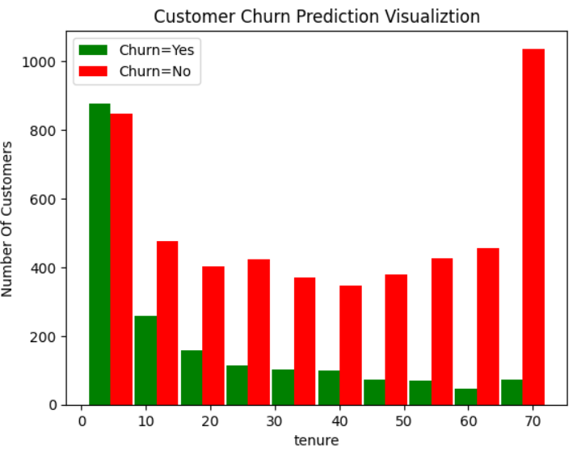
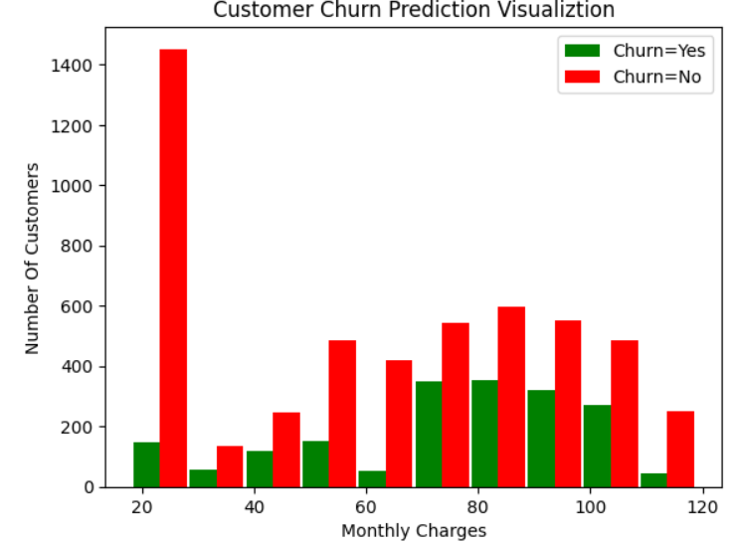
Data visualization

Slide 6
Data Preprocessing
Handling Missing Values:
Identified and addressed missing values in 'TotalCharges' by imputing with median values.
Ensured data completeness and accuracy for subsequent analysis.
Encoding Categorical Variables:
Converted categorical variables like 'gender', 'SeniorCitizen', 'Partner', 'Dependents', etc., into numerical format using one-hot encoding or label encoding.
Transformed categorical data into a format that can be easily interpreted by machine learning algorithms.
Feature Scaling:
Applied feature scaling techniques like Min-Max scaling or Standardization to normalize numerical features like 'tenure', 'MonthlyCharges', and 'TotalCharges'.
Ensured all features have a similar scale to prevent bias in model training.
Feature Selection:
Selected relevant features based on correlation analysis, feature importance, and domain knowledge.
Eliminated redundant or irrelevant features to improve model performance and interpretability.
Data Splitting:
Split the preprocessed data into training and testing sets using a stratified approach to maintain the class distribution (churned vs. non-churned customers).

Slide 7
Exploratory Data Analysis (EDA)
Data Distribution:
Analyzed the distribution of key numerical features like 'tenure', 'MonthlyCharges', and 'TotalCharges'.
Identified any skewness, outliers, or anomalies in the data distribution and addressed them appropriately.
Customer Churn Analysis:
Investigated the churn distribution across different categorical variables such as 'gender', 'SeniorCitizen', 'Partner', 'Dependents', etc.
Explored the churn rate by segmenting the data based on various customer attributes to identify potential churn patterns or trends.
Correlation Analysis:
Conducted correlation analysis to identify relationships between numerical features and the target variable ('Churn').
Visualized correlation matrices and heatmaps to visualize the strength and direction of correlations between variables.
Data Visualization:
Created data visualizations including histograms to represent the data distribution, patterns, and relationships.
Utilized visualizations to highlight key insights, trends, and anomalies present in the data and to communicate findings effectively.

Slide 8
Model Building
Feature Selection:
Identified and selected relevant features or predictors that are most informative and impactful in predicting customer churn.
Conducted feature engineering to create new variables or transform existing ones to capture meaningful patterns and relationships in the data.
Data Splitting:
Split the dataset into training, validation, and test sets to train, tune, and evaluate the model's performance effectively.
Ensured a balanced distribution of churn and non-churn samples across the datasets to prevent class imbalance issues and biased model predictions.

Slide 9
Model Building (Continue)
Model Selection:
Evaluated and selected appropriate machine learning algorithms or models suited for binary classification tasks, such as Logistic Regression, Random Forest, Gradient Boosting, etc.
Considered the model's complexity, interpretability, and performance metrics to choose the most suitable model for predicting customer churn.
Model Training:
Trained the selected machine learning models on the training dataset using optimized hyperparameters and cross-validation techniques to improve model generalization and robustness.
Monitored the model's training process and performance metrics to ensure convergence and avoid overfitting or underfitting issues

Slide 10
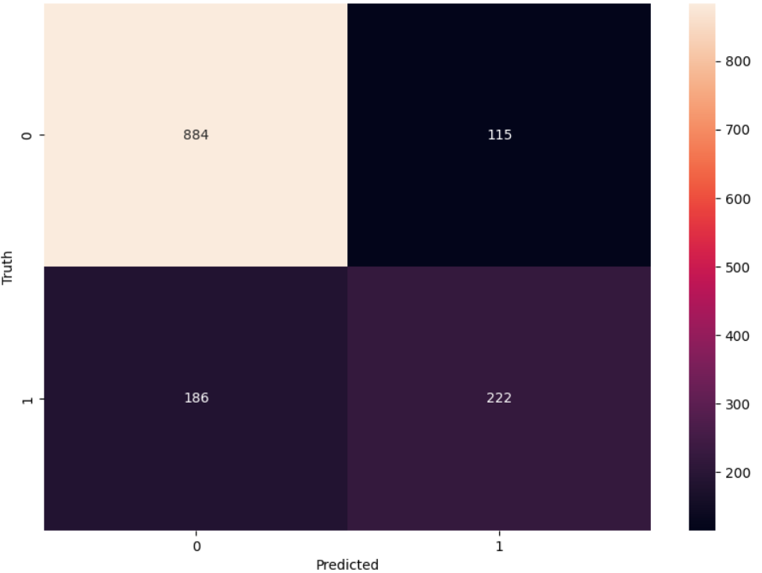
Model Evaluation
Model evaluation is a crucial phase in the customer churn prediction process, where we assess the performance, reliability, and generalizability of the trained machine learning models to ensure accurate and actionable predictions.
By employing diverse evaluation metrics and techniques, we can effectively measure the model's predictive accuracy, robustness, and suitability for real-world applications.

Slide 11
Thank You!

